Slide 1
SESSION 36 · PHASE 10 · AI AGENTS & LANGGRAPH
Multi-Agent Systems
Supervisors, specialists, and how agents talk to each other
From one agent that does everything, to a team that divides the work
45 minutes · theory session · no code today

Slide 2
TODAY
Where the 45 minutes go
1
Why one agent stops being enough
5 min
2
Supervisor + specialist architecture
16 min
3
A worked example, and when NOT to do this
6 min
4
Agent communication patterns
12 min
5
What goes wrong — and recap
6 min
Pure theory. Wednesday's lab builds exactly this architecture in LangGraph — today is the map you will need to read the code.

Slide 3
WHERE WE LEFT OFF
Session 35 gave you one agent. Today: several.
An agent
LangGraph
A single loop
Model, tools, state and a loop. It decides its own path at runtime.
Nodes do the work, edges decide what runs next. State is shared and checkpointed.
One context window, one plan, one set of tools, one thing happening at a time.
The question that starts today
What happens when the job is bigger than one agent, one context window, or one set of tools?
Everything from Session 35 still applies. A multi-agent system is made of agents — each one is still a model, tools, state and a loop.

Slide 4
PART ONE · 21 minutes
Supervisor + Specialist Agents
The architecture: who plans, who works, and how a task travels between them.

Slide 5
THE MOTIVATION
Four symptoms that one agent has outgrown itself
Tool overload
Prompt sprawl
Thirty tools with overlapping descriptions. The model picks the wrong one, and better naming has stopped helping.
The system prompt has become a rulebook: if the user is a refund case, but only when the order is over 30 days…
Context saturation
No parallelism
One window holds the goal, the history, every tool result and every document. Quality quietly degrades.
Twelve sources to check. One agent checks them one at a time, because there is only one loop.
OpenAI's guidance is to maximise a single agent first — add tools incrementally, and only split when prompts and tools genuinely stop scaling.

Slide 6
DEFINITION
What a multi-agent system actually is
“A collection of agents designed to interact through orchestration, enabling collective intelligence.”
Cemri et al., Why Do Multi-Agent LLM Systems Fail? (NeurIPS 2025)
1
2
3
Agents
Orchestration
Communication
Each has its own prompt, its own tools, its own context. Individually, just the agent you already know.
The rules for who runs, when, and with what. This is the part that is genuinely new.
What travels between them — instructions down, results up, context sideways.
The vocabulary varies by vendor: supervisor, orchestrator, coordinator, lead agent, manager, router. They all mean the same role.

Slide 7
THE SUPERVISOR AGENT
A job description, in five duties
1
Understand the goal
Read the request and work out what “done” looks like.
What it does not do
The work itself.
The supervisor does not search, does not write SQL, does not draft the report. It owns the plan, not the labour.
Give it domain tools and it will quietly start doing the job itself — and you are back to one overloaded agent.
2
Decompose
Split the goal into sub-tasks a single specialist can finish.
3
Delegate
Choose the right specialist and write it a clear brief.
4
Track and decide
Read what comes back. Is it enough? Retry, re-route, or move on.
5
Aggregate
Turn a pile of partial results into one coherent answer.
In most frameworks the supervisor is itself an LLM agent — its “tools” are the specialists.

Slide 8
THE SPECIALIST AGENT
An agent that has been made deliberately small
One domain
Its own prompt
A small toolset
Flights. Not travel. Not “anything the user asks”.
Written for that job only — short, specific, testable.
Three or four tools it can tell apart, not thirty it cannot.
Its own context
Returns a result
Replaceable
It sees the brief, not the whole conversation.
A finished answer, not an invitation to keep chatting.
Swap the model, the prompt or the tools without touching the rest.
Specialisation is not about making agents clever. It is about making each one's decision space small enough that it stops guessing.
Rule of thumb: if you cannot write the specialist's job title on one line, it is not a specialist yet.

Slide 9
THE DELEGATION CYCLE
How one task travels down and back up
SUPERVISOR
plans · delegates · aggregates
task brief ▼
▲ result back up
SPECIALIST
own prompt · own tools
SPECIALIST
own prompt · own tools
SPECIALIST
own prompt · own tools
1
2
3
4
5
6
Goal arrives
Decompose
Delegate
Specialist runs its own loop
Result returns
Evaluate → loop again, or answer
Steps 4 and 5 are the whole idea: the specialist runs a complete agent loop of its own, and the supervisor only ever sees the outcome.

Slide 10
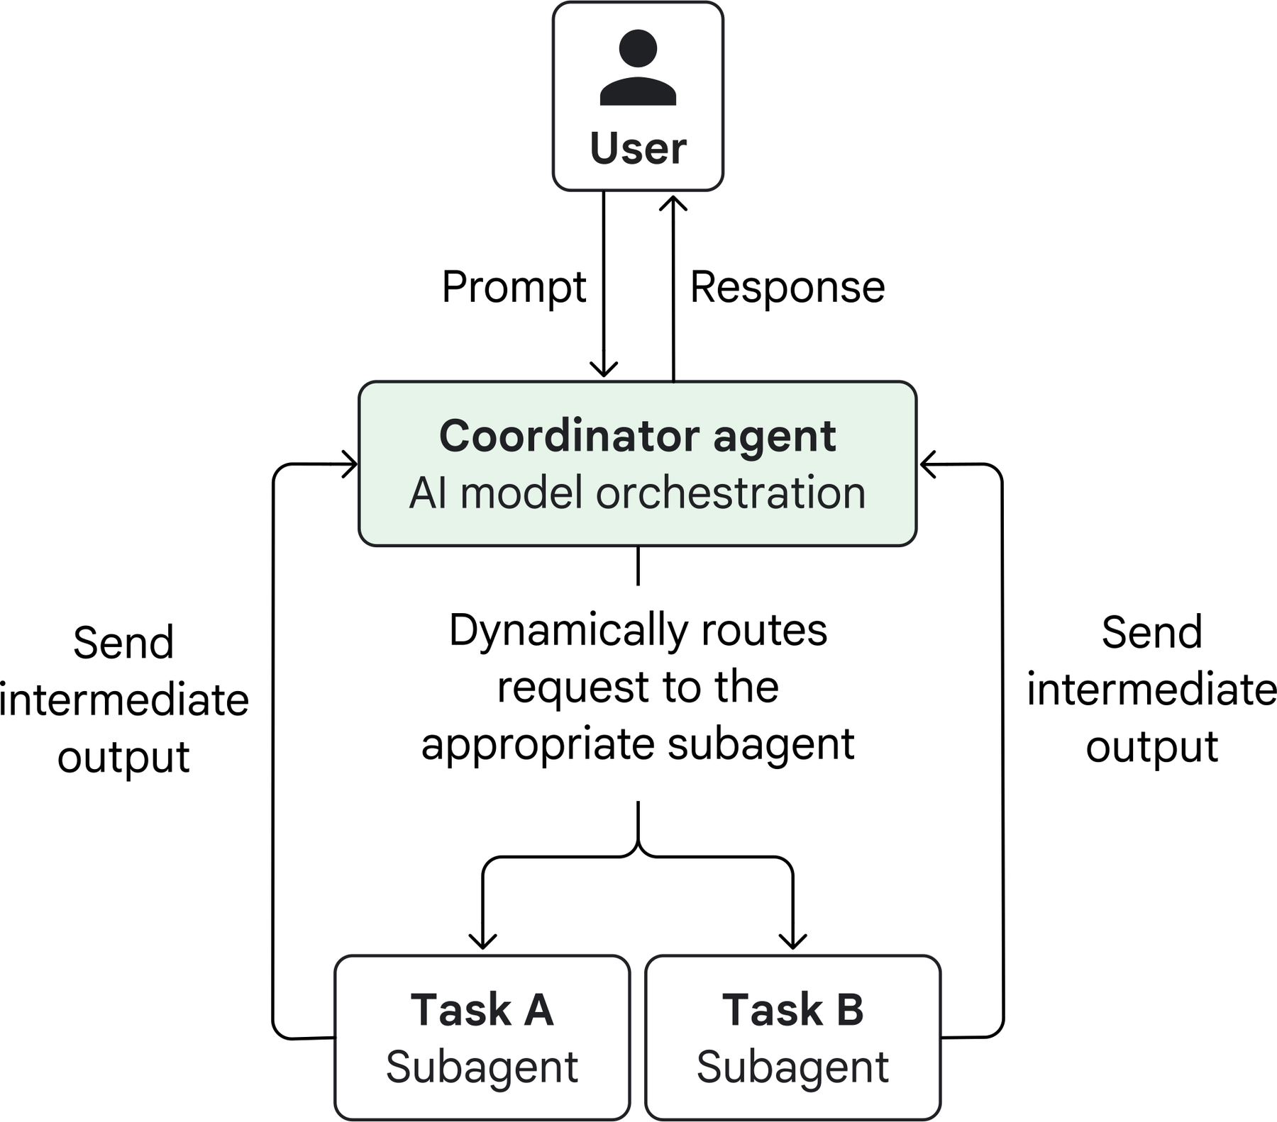
THE SAME IDEA, AS GOOGLE DRAWS IT
The coordinator pattern
The coordinator is an agent, not a switch
It uses a model to decide routing at runtime, which is why it copes with inputs you did not anticipate.
Subagents never talk to the user
Everything the user sees has passed back through the coordinator.
“Intermediate output”
The specialist returns a partial result. The coordinator decides whether that is enough or another agent is needed.
The cost
Every hop is another model call. More flexibility, more tokens, more latency.
Diagram: Google Cloud Architecture Center — “Choose a design pattern for your agentic AI system”, coordinator pattern.

Slide 11
TASK DECOMPOSITION
What has to be in a task brief
1
2
3
4
Objective
Output format
Tools and sources
Boundaries
What question this specialist is answering — in one sentence.
A list? A number? JSON with three fields? Say so.
Which tools to use, and which sources to trust.
What this agent must not do, so two agents don't do the same work.
✗ Too vague
✓ Specific enough to act on
“Research the semiconductor shortage.”
“Find 2026 capacity announcements by TSMC only. Return a table: fab, node, date, source URL.”
Two subagents duplicate each other, a third misreads the scope entirely, and the supervisor gets three overlapping essays.
One agent, one scope, one shape of answer the supervisor can merge.
Anthropic found this was the single biggest fix in their research system: vague delegation produced duplicated and misinterpreted work.

Slide 12
COMING BACK UP
Three things a specialist can return — and what each costs you
RARELY
SOMETIMES
DEFAULT
The whole transcript
The final message only
A structured result
Every thought, tool call and observation.
Just the specialist's last answer, as text.
Findings, confidence, sources, and a status field.
Supervisor sees everything — and drowns. Context fills after two or three specialists.
Cheap and simple, but the supervisor cannot tell a confident answer from a guess.
Compact, comparable, mergeable. The supervisor can reason about it instead of re-reading it.
Design principle: the supervisor's context is the scarcest resource in the system. Everything that flows upward should be a summary, not a recording.
This is why “agent-as-tool” designs work well — a tool call returns a value, not a conversation.

Slide 13
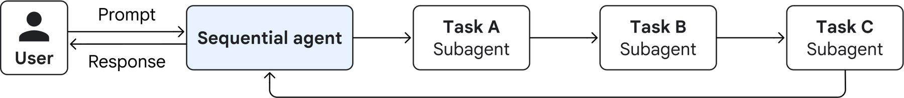
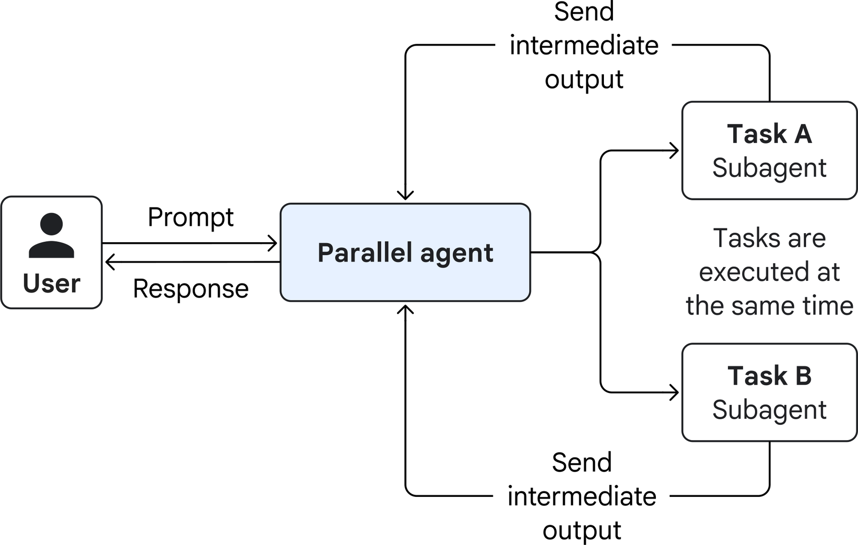
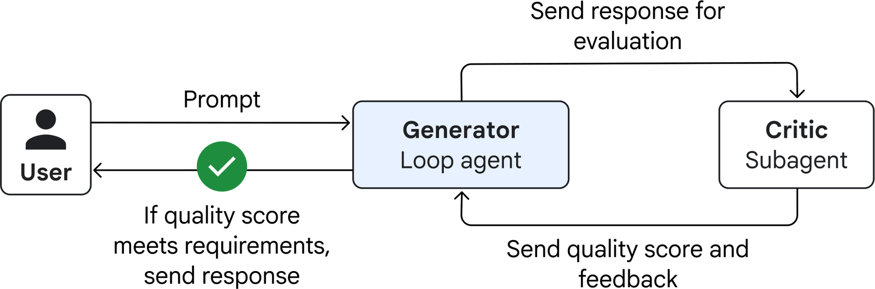
ORCHESTRATION
Three shapes the supervisor can impose on the work
SEQUENTIAL
Output of one is the input of the next. Cheap, predictable, rigid.
PARALLEL
LOOP / REVIEW
Independent sub-tasks run at once, then get synthesised. Big latency win, same token bill — often larger.
A generator and a critic, repeating until the critic approves — or until the retry limit stops them. Quality up, cost up.
Diagrams: Google Cloud Architecture Center — sequential, parallel and review-and-critique patterns.

Slide 14
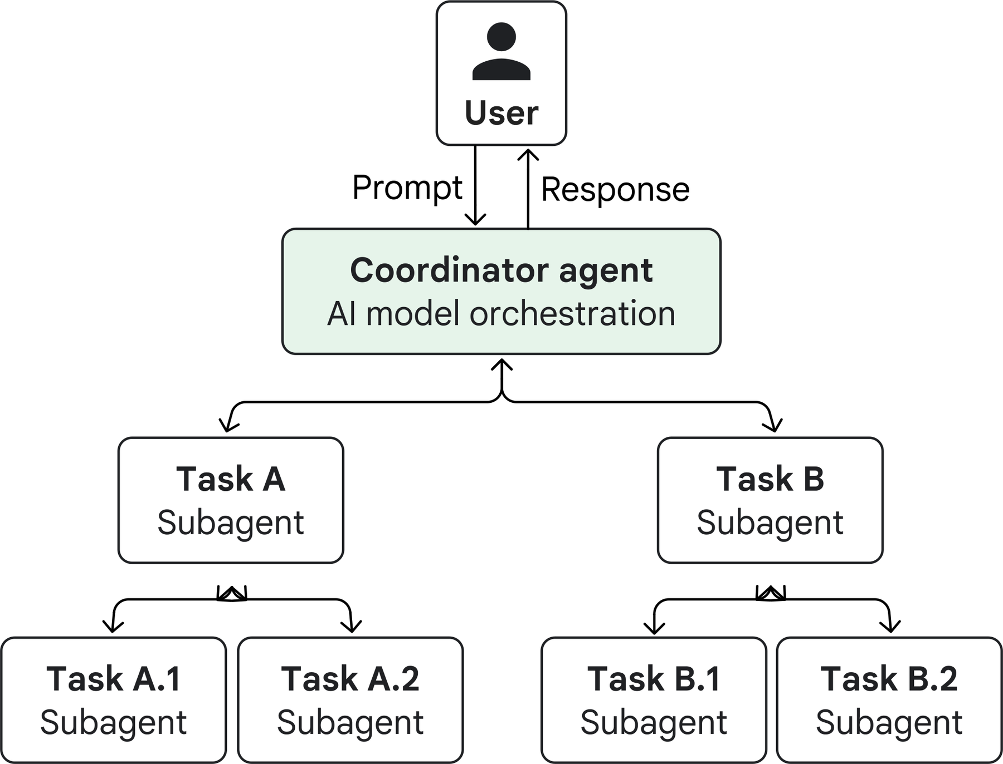
GOING DEEPER
Hierarchical decomposition — a supervisor of supervisors
Why you would
A sub-task is still too big for one agent
Different branches need different tool sets entirely
Teams own their own branch and ship independently
Why you probably should not
Every layer adds a full model call on the way down and another on the way up. Three layers deep, a single question can cost dozens of calls and tens of seconds before any real work starts.
Diagram: Google Cloud Architecture Center — hierarchical task decomposition pattern. · Two levels covers almost every real system.

Slide 15
A WORKED EXAMPLE
“Give me a competitor briefing on Acme for Monday's board meeting”
BRIEFING SUPERVISOR
owns the plan and the final document
News scout
Financials
Product diff
Editor
web search
SQL + filings
internal RAG
no tools
What has Acme announced in the last 90 days?
Revenue, margin and headcount trend from our warehouse
Feature-by-feature gaps against our own roadmap
Turns three findings into one two-page brief
Notice: no specialist knows there is a board meeting. Each one has a job, not the goal. Only the supervisor holds the goal.

Slide 16
THE SAME EXAMPLE
What actually happens, step by step
Supervisor
Plans: I need news, numbers, product gaps. Three briefs, run in parallel.
→ News scout
Brief: “Acme announcements since 1 May. Return: date, headline, source URL.”
→ Financials
Brief: “Acme revenue and margin, last 8 quarters. Return: table + one-line trend.”
→ Product diff
Brief: “Compare Acme's shipped features to our roadmap. Return: top 5 gaps.”
← News scout
6 announcements, with links. Confidence: high.
← Financials
Table returned. Flag: Q2 figures are analyst estimates, not filed.
← Product diff
5 gaps returned, 2 marked uncertain.
Supervisor
Two sources disagree on headcount. Re-brief the news scout to check one claim.
→ Editor
Brief: “Write a two-page brief from these three findings. Flag the estimate.”
Supervisor
Returns the brief to the user. Nine model calls, roughly forty seconds.
The interesting line is the eighth: the supervisor noticed a conflict and spent another call resolving it. That judgement is the supervisor's real job.

Slide 17
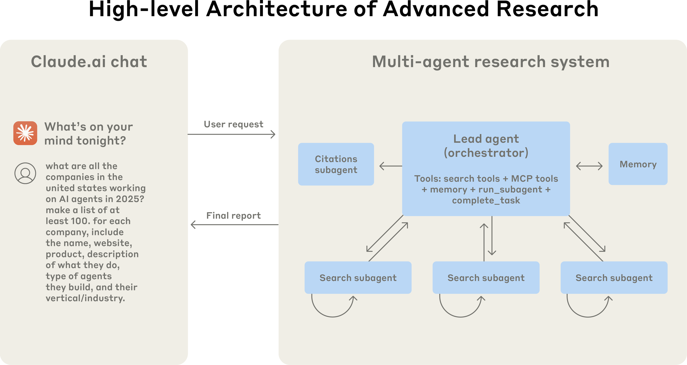
A REAL SYSTEM
Anthropic's multi-agent research system
+90.2%
over a single agent on their internal research eval
15×
more tokens than an ordinary chat interaction
80%
of score variance explained by token spend alone
Read it as a trade: they bought a large accuracy gain with a large token bill. That trade only makes sense when the answer is worth it.
Diagram and figures: Anthropic Engineering — “How we built our multi-agent research system”.

Slide 18
THE UPSIDE
What the supervisor–specialist pattern buys you
Separation of concerns
Context isolation
Parallelism
Each agent has one job, one prompt, one small tool set — and can be tested on its own.
A specialist's messy intermediate work never lands in anyone else's window.
Independent sub-tasks run at the same time instead of queueing behind each other.
Scales by addition
Right model per job
A place to govern
A new capability is a new specialist plus one line in the supervisor's roster.
A cheap fast model for extraction, an expensive one for planning.
One choke point to log, rate-limit, audit and require approval at.
Note that four of these six are about context and control — not about the agents being smarter.

Slide 19
THE DOWNSIDE
What it costs you — every time
Token multiplication
Latency stacks
Coordination failures
Every hop re-states context. Anthropic measured about 15× a normal chat.
Plan, delegate, work, return, synthesise — each is a full model call in sequence.
Roughly 37% of observed failures are agents mis-coordinating, not agents being wrong.
Harder to debug
Duplicated work
Conflicting answers
The bug is rarely in one agent. It is in what the third one was told.
Two specialists with overlapping briefs solve the same problem twice, differently.
Someone has to decide who is right. If nobody does, the user decides — badly.
Failure-rate figures: Cemri et al., Why Do Multi-Agent LLM Systems Fail? — 200+ annotated traces across 7 frameworks.

Slide 20
THE DECISION
Do you actually need more than one agent?
Go multi-agent when…
Stay single-agent when…
Sub-tasks are genuinely independent and can run in parallel
Every step depends on the previous one — there is nothing to parallelise
The work does not fit in one context window
All agents would need the same shared context anyway
Tool sets are large and don't overlap — 30 tools, four clean groups
Latency matters more than depth (a live chat, a UI)
Different steps need different models or different permissions
You have not yet tried better tool names and a tighter prompt
Separate teams need to own and deploy pieces independently
The task is well-defined and repeatable — a workflow beats an agent team
The answer is valuable enough to justify 5–15× the tokens
You cannot yet evaluate the single agent you already have
The honest default: one agent, more tools, better prompt. Reach for a second agent when you can name which of the left-hand rows applies.

Slide 21
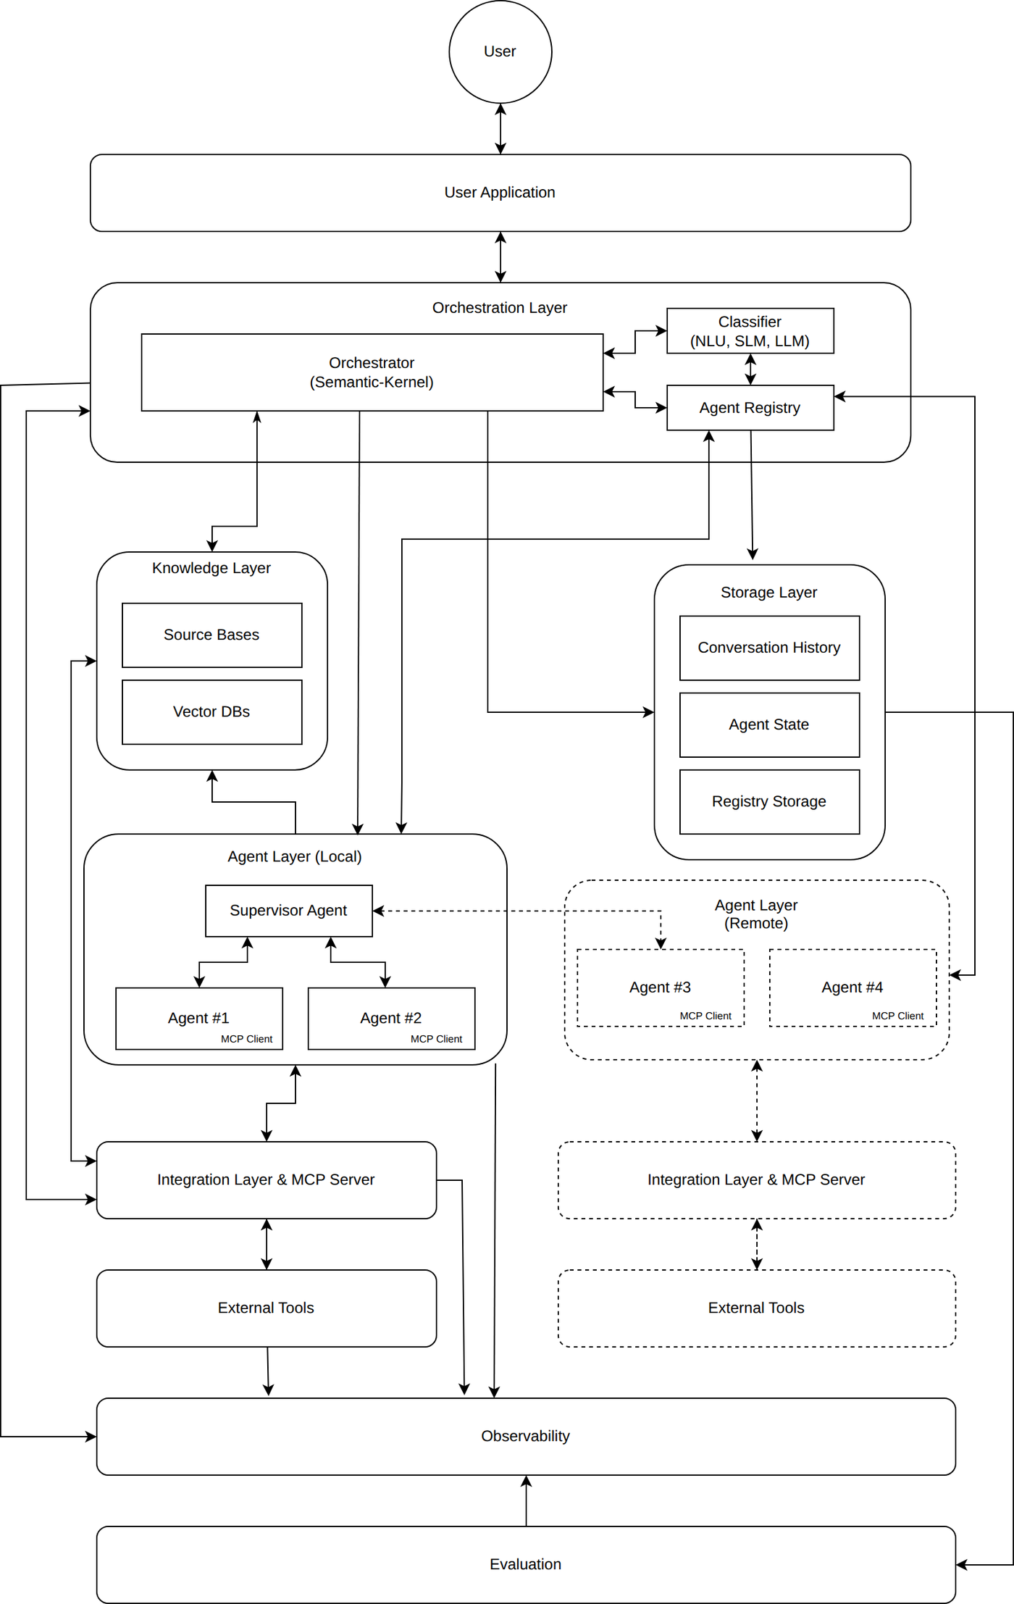
THE ENTERPRISE VIEW
Microsoft's Multi-Agent Reference Architecture
Orchestration layer
A classifier decides whether this request even needs multiple agents — cheap NLU first, an LLM only if it is unsure.
Agent registry
Agents register their capabilities and endpoints, so the supervisor can discover them at runtime instead of being hard-coded.
Supervisor agent
Sits inside the agent layer. Decomposes the request, delegates to agents #1–#4, aggregates the answers.
Local and remote agents
Some specialists run in your process; others are services over the network. The pattern is identical either way.
Observability and evaluation
Drawn as layers spanning everything — in a multi-agent system they are structural, not optional extras.
Diagram: Microsoft — Multi-Agent Reference Architecture (microsoft.github.io/multi-agent-reference-architecture).

Slide 22
PART TWO · 18 minutes
Agent Communication
What travels between agents, how it travels, and every way that goes wrong.

Slide 23
FIRST PRINCIPLES
Three different things are travelling between agents
CONTROL
DATA
CONTEXT
Who runs next?
What did you find?
What do you need to know?
“Your turn.” A delegation, a handoff, a return. Get this wrong and two agents run at once — or none do.
The findings, the table, the draft, the error. The actual payload of work.
The goal, constraints, what has already been tried. The expensive one — it grows with every hop.
Most “communication problems” in multi-agent systems are actually context problems: the right agent got the turn, and the wrong information came with it.

Slide 24
PATTERN 1
Supervisor-mediated — everything goes through the hub
SUPERVISOR
Also called
hub-and-spoke
star topology
manager pattern
agents-as-tools
Agent 1
Agent 2
Agent 3
Agent 4
no line runs between the agents — by design
Good
Bad
One place to log, audit and enforce policy. Deterministic sequencing. Easy to reason about and easy to draw.
The hub is a bottleneck and a single point of failure — and every message costs an extra hop through its context.

Slide 25
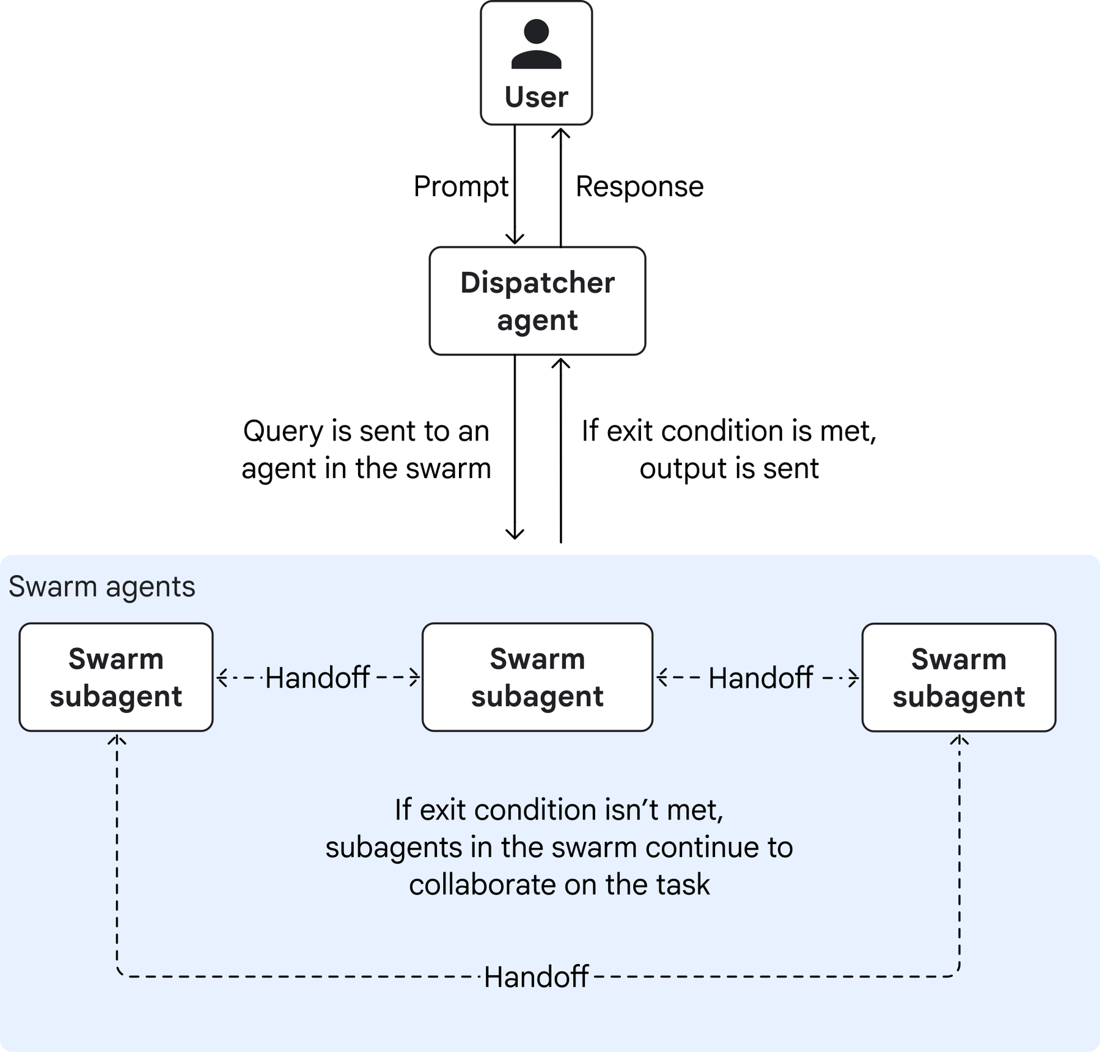
PATTERN 2
Direct agent-to-agent — peers, and handoffs
HANDOFF
A one-way transfer of control. The receiving agent takes over the conversation; the sender steps out.
Good
Lower latency — no round-trip through a hub. Specialists can pull in the exact peer they need, when they need it.
Bad
No single place to observe or govern. Loops become possible: A hands to B, B hands back to A, forever.
Use it
Trusted pairs of agents, performance-sensitive paths, and conversational products where one persona should take over.
Diagram: Google Cloud Architecture Center — swarm pattern. · OpenAI calls the same idea the “decentralised pattern”.

Slide 26
MESSAGE-BASED COMMUNICATION
The vocabulary, borrowed from the A2A protocol
Agents that were built by different teams, in different frameworks, need an agreed envelope. A2A is the open standard for that envelope.
Agent Card
Task
Message
A JSON description of who this agent is, what it can do, where to reach it and how to authenticate. Discovery.
The unit of work. Has an id and a lifecycle: created → working → input-required → completed / failed / cancelled.
One turn. Has a role (user or agent) and carries one or more parts.
Part
Artifact
Context id
The smallest piece of content: text, a file reference, or structured data.
What the agent produced — a document, an image, a table. Also made of parts.
Groups related tasks and messages so a follow-up knows what it follows.
You do not have to use A2A. You do have to decide what your equivalent of each of these six things is — otherwise agents exchange unlabelled prose.

Slide 27
REQUEST / RESPONSE
The synchronous case — and where it stops working
SUPERVISOR
request · the task brief
SPECIALIST
response · the result
…and the supervisor waits
Works beautifully when tasks are short
Falls over when they are not
Simple — The supervisor's code reads like ordinary function calls.
Blocking — Nothing else happens while the specialist works.
Predictable — One request, one result. Errors surface immediately.
Timeouts — A ten-minute research task does not fit in an HTTP request.
Easy to trace — Request and response are a matched pair in your logs.
Serial latency — Four specialists in sequence means four waits, added up.

Slide 28
ASYNCHRONOUS COMMUNICATION
Three ways to find out that a long task has finished
1
Polling
2
Streaming
3
Push / webhook
“Are we there yet?”
Tell me as you go
Call me back
The caller asks for the task status every few seconds. Trivial to build, wasteful at scale, and always a little bit late.
The agent pushes events over a live connection (server-sent events). The user sees progress; the caller can stop early.
The agent POSTs to a URL you gave it when the task changes state. Survives hours-long work and disconnected clients.
Why this matters more than it sounds
Async is what lets a supervisor fan out to five specialists at once instead of waiting for each in turn. Parallelism is not a separate feature — it is what you get once communication stops blocking.
Task lifecycle and the polling / streaming / push triple: Agent2Agent (A2A) protocol specification.

Slide 29
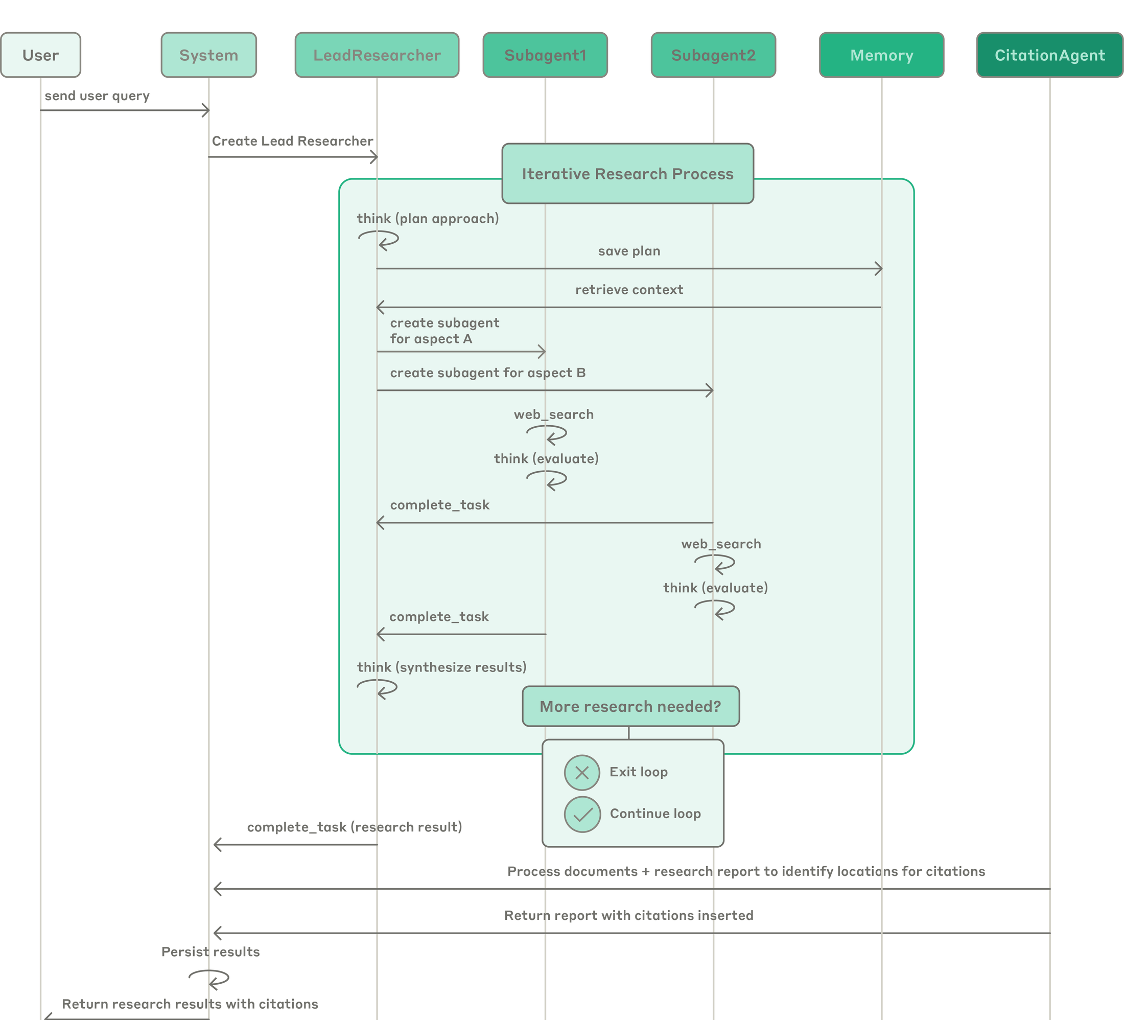
ALL OF IT IN ONE PICTURE
A real multi-agent trace, read top to bottom
Each column is an agent
Vertical lines are lifetimes, horizontal arrows are messages. The standard way to read agent traffic.
“create subagent for aspect A”
Delegation: a task brief travelling down, with a scope attached to it.
Two subagents, side by side
Their loops overlap in time — only possible because the calls do not block.
“complete_task”
The result travelling back up. Note what does not travel: the subagent's own search history.
Memory is a participant
The plan is written to memory, not just held in context — so a crash is survivable.
“More research needed?”
Somebody must own the decision to iterate or stop. Here it is the lead agent.
Diagram: Anthropic Engineering — “How we built our multi-agent research system”.

Slide 30
SHARED STATE
The other way to communicate: don't send anything
SHARED STATE / BLACKBOARD
goal · findings so far · decisions · scratchpad
Agent 1
Agent 2
Agent 3
Agent 4
read
write
Why it is nice
Why it bites
No message plumbing. Any agent can see what has already been established. This is exactly LangGraph's state object — one typed dictionary every node reads and updates.
Two agents writing the same key overwrite each other. The state grows until everyone's context is full of everyone else's notes. And “who changed this?” gets hard to answer.
Reducers exist for exactly this reason — they say how concurrent updates combine instead of clobbering.

Slide 31
STRUCTURED MESSAGES AND HANDOFFS
Prose is a bad interface between machines
✗ Free text
✓ Structured
“I looked into the Acme thing and it seems like revenue is up, though the Q2 number might be an estimate, you may want to check that.”
finding: revenue +12% YoY confidence: medium caveat: Q2 is an analyst estimate sources: [3 urls] status: complete
The supervisor now has to parse a vibe.
Now it can be compared, merged and checked.
A handoff is two things at once
Control
Context payload
What to leave out
“You are now driving.” The sender stops; the receiver continues.
What the receiver needs: the goal, what has been tried, what was decided and why.
The sender's own reasoning trace, failed attempts and raw tool dumps — unless they change the next decision.
A handoff that forwards the entire conversation is not a handoff — it is a context leak with extra steps.

Slide 32
SIDE BY SIDE
Four communication patterns, four different bills
LATENCY
OBSERVABILITY
COUPLING
BEST FOR
Supervisor-mediated
Higher — every hop via the hub
Excellent — one place to log
Low between agents
Compliance, audit, strict sequencing
Direct agent-to-agent
Lower — no round trip
Poor unless you add tracing
High — agents know each other
Trusted pairs, latency-critical paths
Message bus / pub-sub
Variable — queue depth
Good — the queue is the log
Very low — by topic
Many agents, bursty load, scaling out
Shared state
Lowest — no messages at all
Medium — needs versioning
Via the schema
Tight teams of agents on one workflow
Real systems mix them: mediated control flow, shared state for the plan, direct calls on the two hot paths. The point is to choose, not to drift.

Slide 33
WHAT GOES WRONG (1)
Context — the failure mode nobody sees coming
Context overload
FIX
Each hop appends. By the fourth agent the window holds three agents' worth of intermediate work, and the model starts missing the parts that matter.
Summarise at every boundary. Pass conclusions, not transcripts.
Information withholding
FIX
An agent finds something decisive and doesn't pass it on, because nothing in its brief said to. The next agent works from an incomplete picture.
Define the return schema. If a field must be filled, it gets filled.
Loss of conversation history
FIX
A handoff drops the constraint the user gave in the first message. The receiving agent cheerfully violates it.
Keep goal and constraints in shared state, not in the message chain.
Two of these three are named failure modes in the MAST taxonomy — they are common enough to have been catalogued.

Slide 34
WHAT GOES WRONG (2)
Coordination — measured, not guessed
Step repetition
17.1%
Agents redo work that was already done — usually because nothing recorded that it was done.
MAST
200+ traces from 7 open-source frameworks, annotated by 6 experts. 14 failure modes in 3 families.
Reasoning–action mismatch
14.0%
The agent explains a sensible plan and then does something else.
Fail to ask for clarification
11.7%
Faced with an ambiguous brief, the agent guesses instead of asking.
41.8%
Specification issues
Unaware of stopping conditions
9.8%
Nobody knows the task is finished, so the loop keeps going.
36.9%
Inter-agent misalignment
Premature termination
7.8%
The opposite: the system declares victory before the work is actually complete.
21.3%
Verification failures
Task derailment
7.2%
The conversation drifts away from the original goal, one reasonable step at a time.
Six of the fourteen modes shown; percentages are shares of all observed failures.
Cemri et al., “Why Do Multi-Agent LLM Systems Fail?”, arXiv:2503.13657 (NeurIPS 2025 Datasets & Benchmarks).

Slide 35
WHAT GOES WRONG (3)
The bill — latency and cost are architectural, not accidental
Where the seconds go
Where the tokens go
Supervisor plans
1.4
4×
an agent versus a single chat message
Delegates 3 briefs
0.6
Specialists work (in parallel)
3.2
15×
a multi-agent system versus a single chat message
Results return
0.5
×N
every specialist re-receives the goal and constraints
Supervisor re-reads and decides
1.8
Editor writes the answer
2.6
×retries
and every loop iteration pays the whole bill again
Total, best case
≈ 10 seconds
Token spend explained 80% of score variance in Anthropic's eval.
The same question, one agent: two calls, about 4 seconds.
Both numbers are design outputs, not surprises. Decide the latency and cost budget first, then pick how many agents fit inside it.

Slide 36
GUARDRAILS
Eight rules that prevent most of what we just listed
Cap everything
One owner per decision
1
2
Max hops, max retries, max sub-agents, max depth. Every loop needs a number.
Exactly one agent decides when the task is done. Never two, never none.
Schema on the way back
Summarise at boundaries
3
4
Specialists return fields, not paragraphs. Empty fields are visible; vague prose is not.
Nothing crosses an agent boundary without being compressed first.
Non-overlapping briefs
Trace with ids
5
6
If two briefs could produce the same sentence, merge them or narrow them.
One task id and one context id through the whole run, or you cannot debug it.
Checkpoint the plan
Escalate, don't guess
7
8
Write it to state, not just to context — so a crash resumes instead of restarting.
Conflicting results go to the supervisor, or to a human. Never to the user unmarked.

Slide 37
RECAP
RECAP
Seven things to walk out with
Seven things to walk out with
1
A supervisor owns the plan. Specialists own the work. Nobody owns both.
2
A specialist is an agent made deliberately small — one domain, few tools, its own context.
3
Decomposition quality decides system quality: objective, output format, tools, boundaries.
4
What travels back up should be a structured summary, never a transcript.
5
Communication is a design choice: mediated, direct, message bus, or shared state.
6
Most failures are coordination failures, not intelligence failures.
7
Multi-agent costs roughly an order of magnitude more. Start with one agent and prove you need more.
Wednesday: we build this — a LangGraph supervisor with two specialists, tools, and a human-in-the-loop checkpoint.

Slide 38
REFERENCES
Where all of this came from
Microsoft — Multi-Agent Reference Architecture
Cemri et al. — Why Do Multi-Agent LLM Systems Fail?
microsoft.github.io/multi-agent-reference-architecture
arXiv:2503.13657 · NeurIPS 2025 · the MAST taxonomy
Google Cloud — Choose a design pattern for your agentic AI system
Agent2Agent (A2A) protocol specification
docs.cloud.google.com/architecture/choose-design-pattern-agentic-ai-system
a2a-protocol.org/latest/specification
Google Cloud — Multi-agent AI system reference architecture
Wu et al. — AutoGen: multi-agent conversation framework
docs.cloud.google.com/architecture/multiagent-ai-system
arXiv:2308.08155
Anthropic Engineering — How we built our multi-agent research system
Yan et al. — Beyond Self-Talk: a communication-centric survey of LLM-MAS
anthropic.com/engineering/multi-agent-research-system
arXiv:2502.14321
OpenAI — A practical guide to building agents
LangChain / LangGraph — multi-agent documentation
manager pattern and decentralised pattern
docs.langchain.com · subagents, handoffs, supervisor
All diagrams are reproduced from the sources named on each slide, for classroom use.

